Slide 1


P.ATHISPAT
June 19, 2023

Slide 2

Outline
Executive Summary
Introduction
Methodology
Results
Conclusion
Appendix

Slide 3
Executive Summary
The methodologies begin with collecting the Falcon 9 from 2 sources: SpaceX API data and Wiki page by scraping. Data wrangling was applied to the data by dealing with missing values. Perform exploratory data using many tools including SQL, visualize with graphs, made interactive visual analytics in map using Folium and create dashboard by Dash. Finally, training various machine learning models to predict Falcon 9 rocket landing success or not
According to the results of 4 models including Logistic regression, Support vector machine, Decision tree, and K-nearest neighbor. Decision tree gave the best performance on accuracy 90.35%

Slide 4
Introduction
SpaceX advertises Falcon 9 rocket launches on its website with a cost of 62 million dollars; other providers cost upward of 165 million dollars each, much of the savings is because SpaceX can reuse the first stage. Therefore if we can determine if the first stage will land successfully, we can determine the cost of launch.

Slide 5

Section 1

Slide 6
Methodology
Executive Summary
Data collection methodology:
Collect data from SpaceX data API and scraping from Wiki page
Perform data wrangling
Dealing with missing values
Perform exploratory data analysis (EDA) using visualization and SQL
Perform interactive visual analytics using Folium and Plotly Dash
Perform predictive analysis using classification models
Standardize, train test split in preprocess data step
GridSearch for tuning in various models and evaluate by confusion matrix

Slide 7
Data Collection
SpaceX - API
Collect data from Space X API including: FlightNumber, Date, BoosterVersion, PayloadMass, Orbit, LaunchSite, Outcome, Flights, GridFins, Reused, Legs, LangingPad, lock, ReusedCount, Serial, Longitude, ad Latitude
Space X Falcon9 – Scraping
Collect data from Falcon9 Launch Wiki page from its URL, and then transform to Data frame including: Flight No., Launch site, Payload, Payload mass, Orbit, Customer, Launch outcome, Version Booster, Booster landing, Date, and Time

Slide 8
Data Collection – SpaceX API
Request and parse the SpaceX data using GET request
Turn JSON to DataFrame
Using columns: rocket, payloads, launchpad, and cores
Get BooterVersion, LaunchSite, PayloadData and CoreData and others
Filter the dataframe to only include “Falcon 9” in BoosterVersion
Replace missing value with Mean
GitHub: spacex-data-collection-api.ipynb
Start
Request GET
Response 200
No
Yes
Select columns
Turn to DataFrame
Use function to get more columns
Select “Falcon9” and dealing missing value
End

Slide 9
Data Collection - Scraping
Request the Falcon9 Launch Wiki page from URL
Using BeautifulSoup for scraping
Extract all columns name from HTML table header
Create a data frame by parsing the launch HTML tables
GitHub: webscraping.ipynb
Start
ScrapingFalcon9 Launch Wiki
Extract all columns name from HTML table header
Create a data frame by parsing the launch HTML tables
End

Slide 10
Data Wrangling
Analyze the data
Identify the missing values
Calculate the number of launches on each site
Calculate the number and occurrence of each orbit
Calculate the number and occurrence of mission outcome per orbit type
Create a landing outcome label (class)
GitHub: spacex-data_wrangling.ipynb
Start
Calculate No. and occurrence of mission outcome per orbit type
Identify the missing values
Create a landing outcome label
Calculate No. of Launches on each site
Calculate No. and occurrence of each orbit
End

Slide 11
EDA with Data Visualization
Scatter and Line chart
Using with numerical to numerical data
To observe the trend and relationship between 2 numerical data
Bar chart
Using with categorical to numerical data
To compare values among the categorical data
GitHub: eda-dataviz.ipynb

Slide 12
EDA with SQL
SELECT DISTINCT: display the unique records
WHERE Launch_Site LIKE ‘CCA%’: display records where Launch_Site with pattern ‘CCA%’
SUM(PAYLOAD_MASS_KG_): display total payload mass
AVG (PAYLOAD_MASS_KG_): display average payload mass
MIN(Date): display minimum date
PAYLOAD_MASS_KG_ BETWEEN 4000 AND 6000: condition mass greater than 4000 but less than 6000
GROUP BY Mission_Outcome: group the data by Mission_Outcome
GitHub: eda-sql-coursera_sqllite.ipynb

Slide 13
Build an Interactive Map with Folium
Map: initial center location of the map
Marker: Create marker of location on the map
Circle: Create circle around the desire location
Lines: Create the line between points on the map
MarkerCluster: A map containing many markers having the same coordination
GitHub: launch_site_location.ipynb

Slide 14
Build a Dashboard with Plotly Dash
Dropdown: use for getting the launch site type as an input, user can select options provided for displaying various graph style according to the option
Pie chart: Display the proportions of success of all launch site for option “All Sites” and display the proportions between success/fail of each launch site selected
Scatter chart: Display compare between Payload Mass (kg) and class
GitHub: dashboard

Slide 15
Predictive Analysis (Classification)
Prepare the data by standardize and split the data into train/test set
Select a model and set parameter of its
Start train the model on training data
Calculate the accuracy score on test data
Decide whether need to train more models or not
Compare result of all models then choose the best model
GitHub: SpaceX_Machine_Learning_Prediction.ipynb
Start
Load the data
Standardize and train/test split the data
Calculate accuracy score on test data
Train the model on training data
Select a model and set parameters
Build more model?
Yes
No
Compare the result of each models
Choose the best model
End

Slide 16
Results
Exploratory data analysis results
Interactive analytics demo in screenshots
Predictive analysis results

Slide 17

Section 2

Slide 18
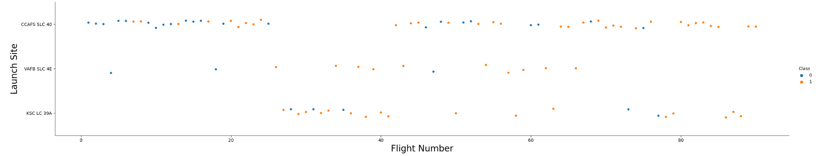
Flight Number vs. Launch Site
The CCAFS SLC 40 has no Flight number from around 25 to 40.
The KSC-LC 39A has no Flight number from 0 to around 20.

Slide 19
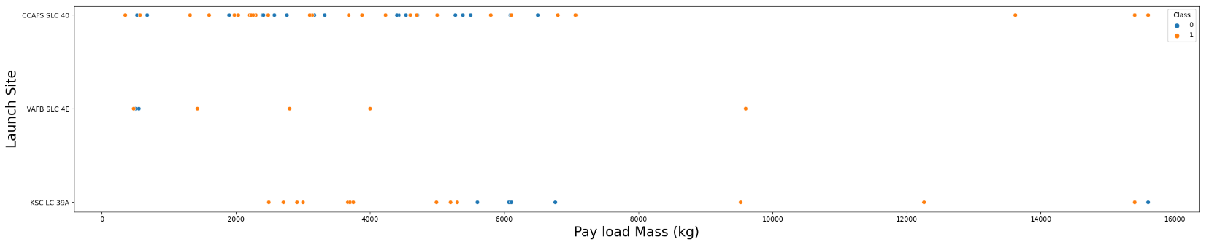
Payload vs. Launch Site
The VAFB-SLC is no rockets launched for heavy payload mass(greater than 10000).

Slide 20
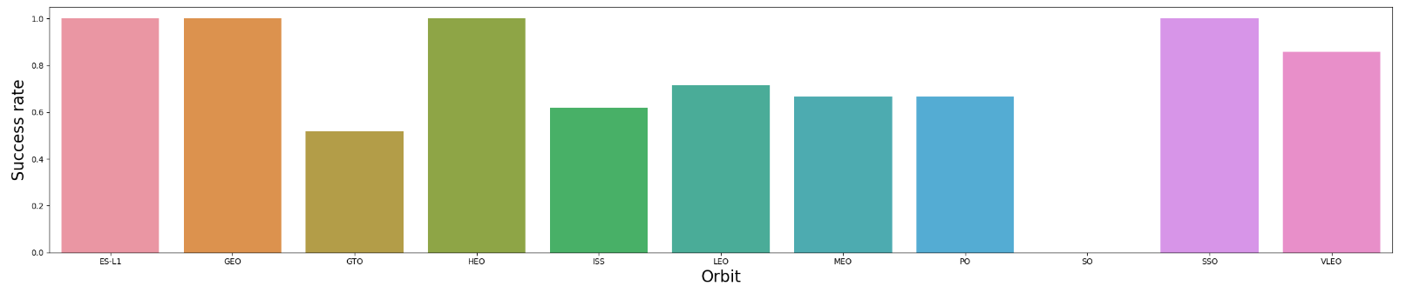
Success Rate vs. Orbit Type
The SO Orbit type has 0 success rate.
The ES-L1, GEO, HEO, and SSO have highest success rate.

Slide 21
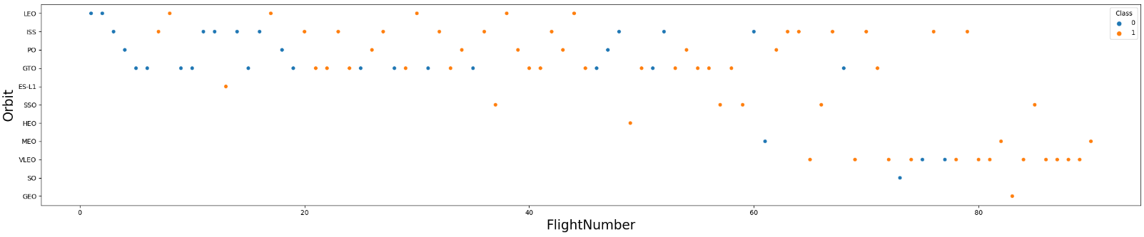
Flight Number vs. Orbit Type
The LEO orbit the Success appears related to the number of flights.
There seems to be no relationship between flight number when in GTO orbit.

Slide 22
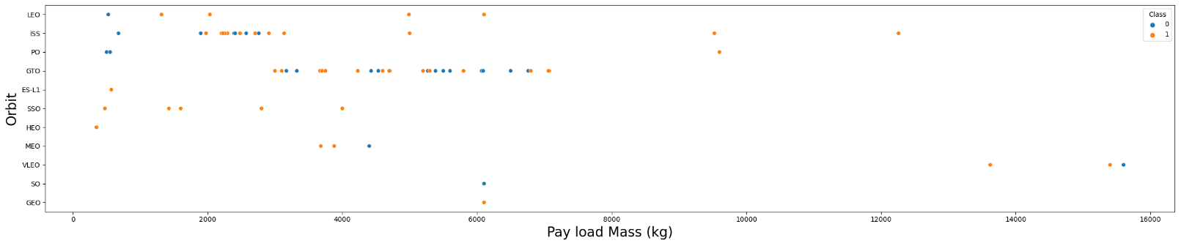
Payload vs. Orbit Type
With heavy payloads the successful landing or positive landing rate are more for LEO and ISS.
GTO we cannot distinguish this well as both positive landing rate and negative landing(unsuccessful mission).

Slide 23
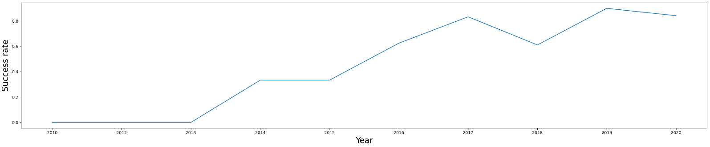
Launch Success Yearly Trend
The success rate since 2013 kept increasing till 2020

Slide 24
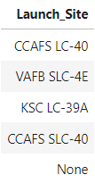
All Launch Site Names
There are 4 distinct Launch Site name including:
CCAFS LC-40
VAFB SLC-4E
KSC LC-39A
CCAFS SLC-40

Slide 25
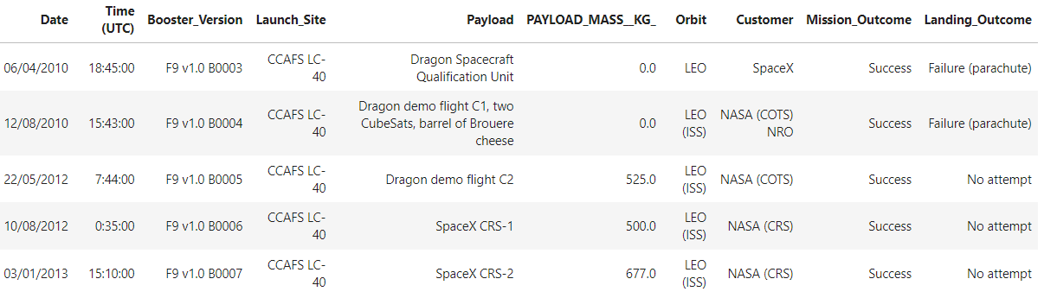
Launch Site Names Begin with 'CCA'
Launch Site name which begin with ‘CCA’ is CCAFS LC-40

Slide 26
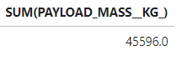
Total Payload Mass
Total payload mass carried by boosters launched by NASA (CRS) is 45596 KG

Slide 27
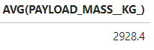
Average Payload Mass by F9 v1.1
Average payload mass carried by booster version F9 v1.1 is 2928.4 KG

Slide 28
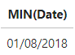
First Successful Ground Landing Date
The dates of the first successful landing outcome on ground pad is August 1, 2018

Slide 29
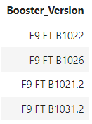
Successful Drone Ship Landing with Payload between 4000 and 6000
There are 4 names of boosters which have successfully landed on drone ship and had payload mass greater than 4000 but less than 6000

Slide 30
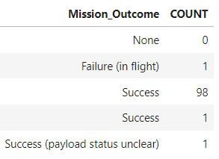
Total Number of Successful and Failure Mission Outcomes
The total number of successful is 100 and failure mission outcomes is 1

Slide 31
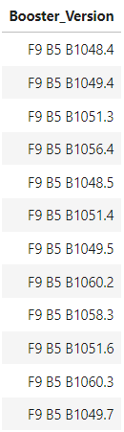
Boosters Carried Maximum Payload
There are list the names of the booster which have carried the maximum payload mass

Slide 32
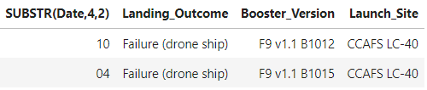
2015 Launch Records
There are list the failed Landing Outcomes in drone ship, their booster versions, and launch site names for in year 2015

Slide 33
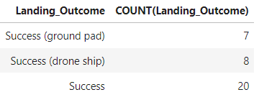
Rank Landing Outcomes Between 2010-06-04 and 2017-03-20
There are the Success Landing Outcomes that ranked by count in descending between the date 2010-06-04 and 2017-03-20
Success (ground pad) is 7
Success (drone ship) is 8
Success is 20

Slide 34

Section 3

Slide 35
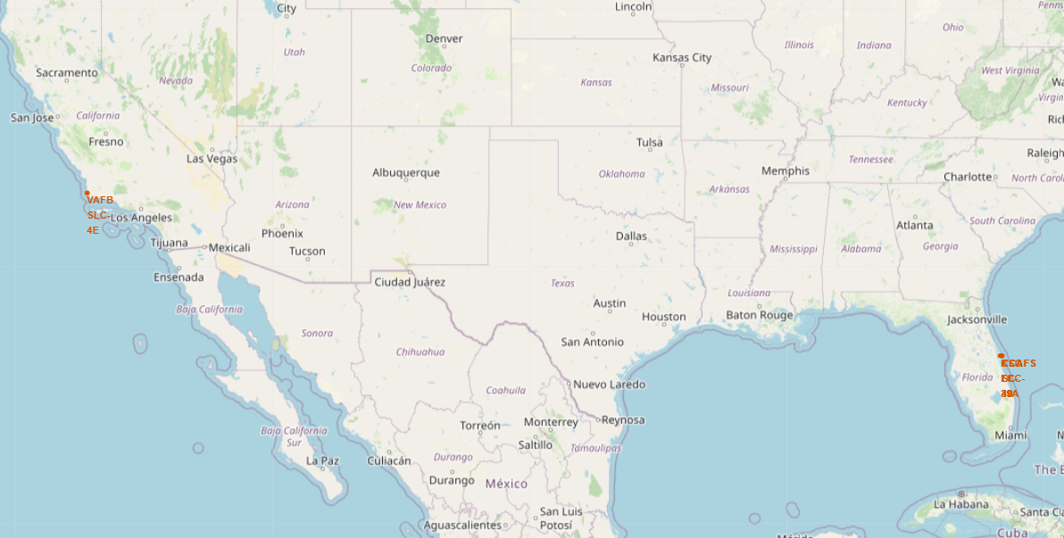
All launch sites
There are 3 launch sites on Florida
CCAFS LC-40 [28.562302, -80577356]
CCAFS SLC-40 [28.563197, -80.576820]
KSC LC-39A [28.573255, -80.646895]
There is a launch site on California
VAFB SLC-4E [34.632834, -120.610745]
All launch sites in very close proximity to the coast

Slide 36
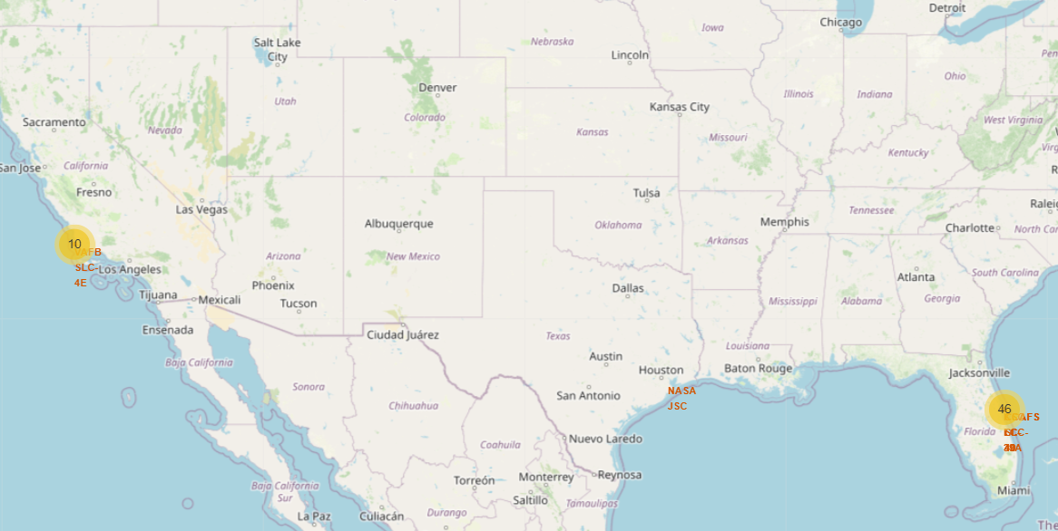
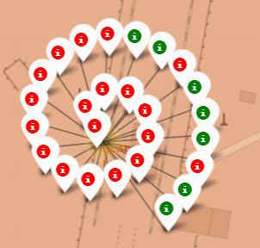
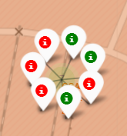
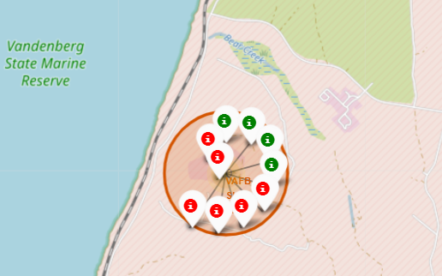
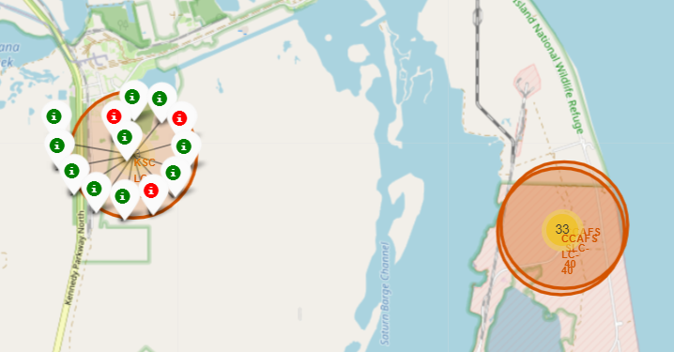
The success/failed launches for each site
KSC LC-39A has success more than others
CCAFS LC-40 has most launch
CCAFS SLC-40
CCAFS LC-40
VAFB SLC-4E
KSC LC-39A

Slide 37
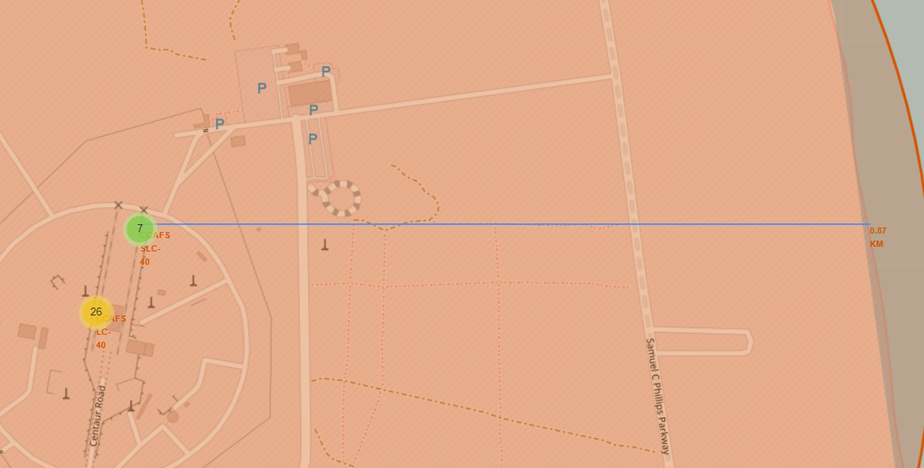
Distances between a launch site to Coast
CCAFS SLC-40 is 0.87 Kilometer to the coastline

Slide 38

Section 4

Slide 39
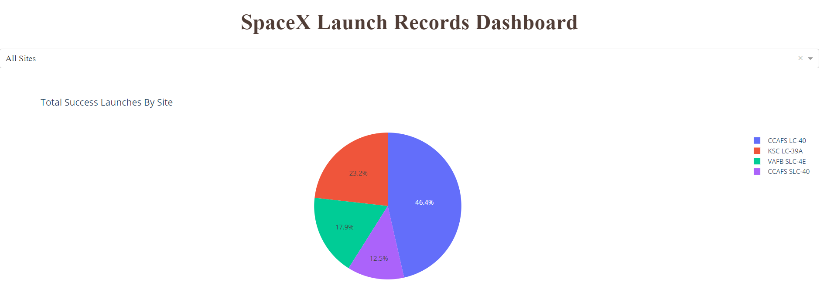
Launch success count for all sites
The CCAFS LC-40 has most number of success launch (46.4%)

Slide 40
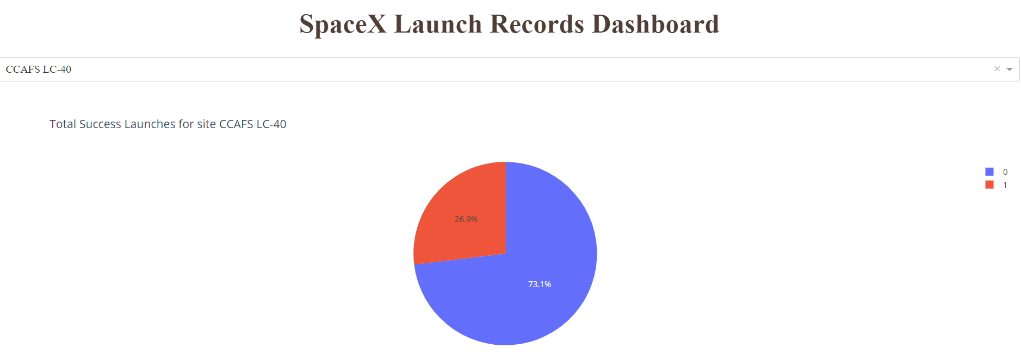
The launch site with highest success ratio
Although the CCAFS LC-40 has high number of success launch but if we look in to the ration, the success rate is quite low 26.9%

Slide 41
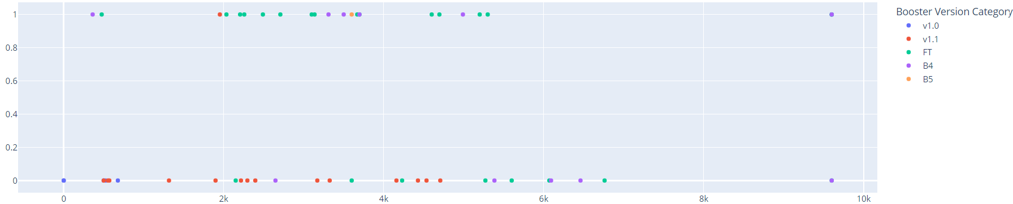
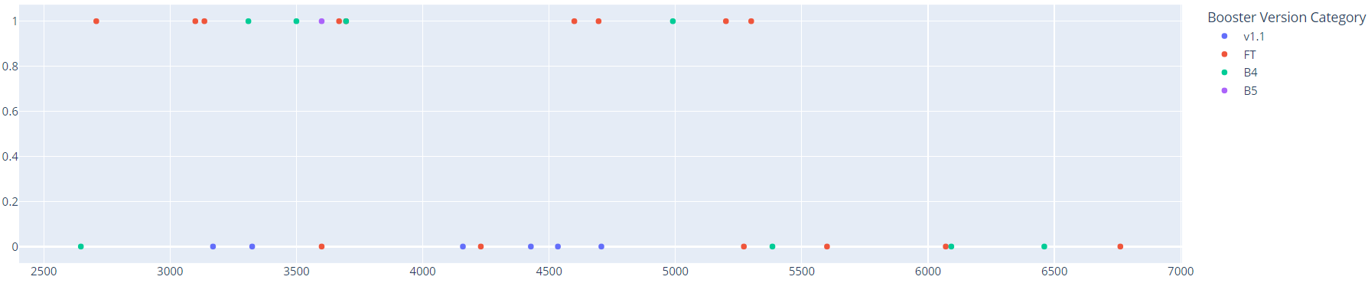
Payload vs. Launch Outcome
The B4 has success launches more than fail.
The v.1.0 is the only Booter Version has Payload more than around 7K.

Slide 42

Section 5

Slide 43
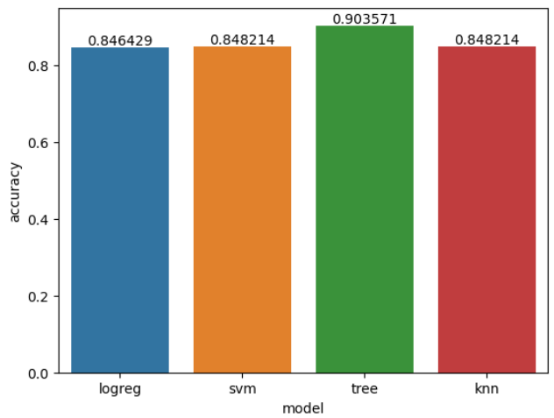
Classification Accuracy
Decision Tree classification has highest accuracy (90.35%)

Slide 44
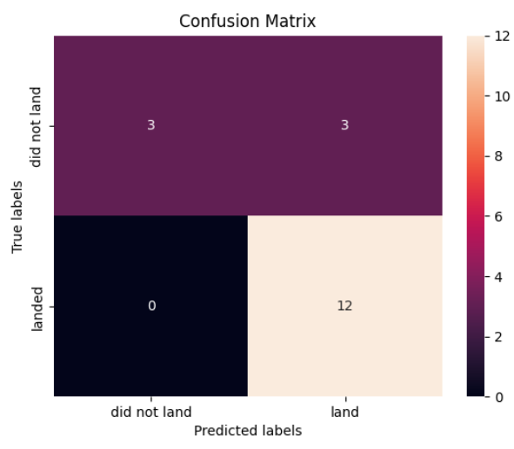
Confusion Matrix
The model can predict the “land” class (positive class) well but “did not land” (negative class) quite not good.
TN: 3 FP: 3
FN: 0 TP: 12

Slide 45
Conclusions
The orbit type of ES-L1, GEO, HEO, and SSO have highest success rate
The LEO orbit success appears related to number of flights but GTO is not
Success rate since 2013 kept increasing till 2020
All launch sites location is near to coast line
The CCAFS LC-40 has high number of success launch buy success rate is quite low
The Decision Tree classification model is the best performance on accuracy 90.35%

Slide 46
Appendix
The relevant assets was stored on GitHub, it’s include all Notebook and Python code that I have created during this project
GitHub: https://github.com/atpluem/dscapstone.git

Slide 47


